Slide 1
Study Jam Machine Learning 1: Math For Machine Learning #1

Slide 2

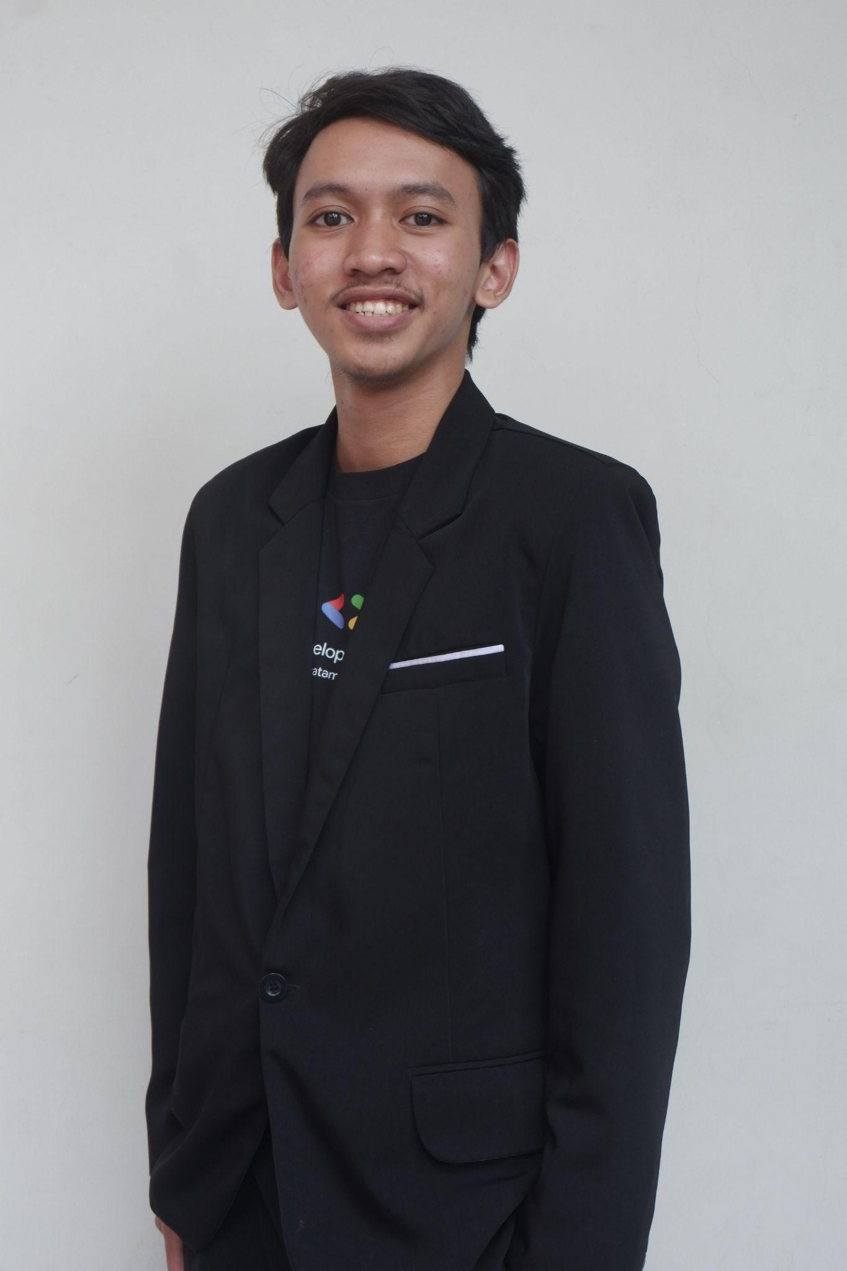



Co-Lead GDGoC Widyatama University
Informatics student at Widyatama University
Bangkit Alumni 2024 batch 1
On Campus Widyatama University
instagram.com/m.syahrindra
linkedin.com/in/m-syahrindra/
M Syahrindra Core Team
github.com/syahrindra

Slide 3
Today’s Topic
Basic Probability
Defining Probability
Conditions of Probability
Joint Probability
Conditional Probability
Independence
Sum Rule
Law of Total Probability
Bayes’ Rule
2. Statistic
Population and sample
Measure of Central Tendency
Central Tendency: Mean (average), Median, Mode
Measure of Dispersion
Dispersion: Range
Dispersion: Variance and standard deviation

Slide 4
Other Resources
YouTube: Kylie Ying, 3Blue1Brown, stanford online, etc
Coursera: Machine Learning courses
Udemy:Machine Learning courses
Dicoding, DataCamp, etc

Slide 5
Basic Probability
Probability is about how likely something is Happen
Sample space
All possible outcome
A2
A1
Event = possible outcome

Slide 6
Basic Probability
Probability is about how likely something is Happen
A1, a2,a3,...a6
S ={1,2,3,4,5,6}
For every A:
P(A) >= 0
P(s) = 1
A1,A2,...An
Disjoint
P(A1 + A2+..An) = P(A1) + P(A2) +...P(An)
P(1) = ⅙ = 0,166
p(2) = 1/6
p(3) =

Slide 7
Joint Probability
What is the probability of two different events happening.
P(x and y)
p( x∩y)
P(x, y)

Slide 8
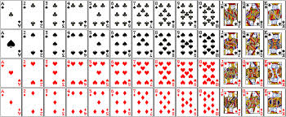
P(black) = 26/52 = ½
P(4) = 4/52 = 1/13
P(4, black) = 2/52 = 1/26
P(A, red) = 1/26

Slide 9
Conditional Probability
Peluang suatu kejadian dengan syarat kejadian lain terjadi
P(x | y) -> prob of event x give event y
P(heart | red) = 13/26 = ½
P(heart | black) = 0/26 = 0
P(4 | black) = 2/26 = 1/13
P(x | y) = P(x,y)/P(y)
P(x|y) * P(y) = P(x,y) /p(y) * p(y)

Slide 10
Independence
Are these two events related or not. Does one event happening affect the other event happening.
P(x)= P(X| y)
P(x,y) = P(x) * P(y)

Slide 11
Sum Rule
event
c1
c2
c3
P(A) = ⅀ P(A, Ci) = P(A, c1) +P(A,c2) +P(A,c3)

Slide 13
Law of Total Probability
P(y) * P(x|y) = P(x,y)/P(y) * P(y)
P(x|y)*P(y) = P(x,y)
P(A) = ⅀ P(A | ci) * P(ci)

Slide 14
Law of Total Probability
Kemungkinan makan mi rebus
Hujan : 90%
Cerah: 10%
Kemungkinan hujan di kopo atau P(hujan) = 20%
P(makan mi rebus) = P(makan mi rebus | rain) * P(rain) + P(makan mie rebus | cerah) * P(cerah)
= 0.9 * 0.2 + 0.1 * 0.8 = 0.18 + 0.08 = 0,26 = 26%

Slide 15
Bayes Rule
Teorema Bayes adalah cara untuk menghitung peluang suatu kejadian berdasarkan informasi baru. Dengan kata lain, kita memperbarui apa yang kita ketahui setelah mendapatkan data tambahan.
P(A|B) = P(A, B)/P(B)
= P(B|A) * P(A)/P(B)

Slide 16
98%
2%
TIDACK COVID
COVID
TEST-
TEST+
TEST-
TEST+
5%
95%
10% 90%
Misal saya mendapat test+ berapa kemungkinan saya benar” memiliki COVID
P(COVID | test+) = P(test+ | covid) * P(covid) / p(test+)
= P(test+|covid) * P(covid) / P(test+ | covid) * P(covid) + P(test+ |tdk covid) * P(tdkcovid)
= 0.95 * 0.02 / (0.95 * 0.02 + 0.1 * 0.98)
= 0.19 / (0.19 + 0.098) = 0.19/0.288 = 0,6597…

Slide 17
Break 5 menit

Slide 18
Statistic

Slide 19
Population and sample

Slide 20
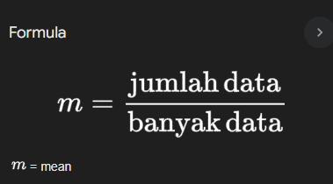
Measure of Central Tendency
Mean (average) rata-rata
Rat” ipk: widyatama = 2.3 + 3.4 + 1.2 + 4.0 + 3.2/5

Slide 21
Measure of Central Tendency
Mean (average) rata-rata
Hitung tinggi badan= 160+ 140+ 130+120+115 + 400 /6 = 177.5

Slide 22
Central Tendency: Mean, Median, Mode
1+2+3+4+5 = 5/2 = 2.5

Slide 23
Central Tendency: Mean, Median, Mode
1,3,4,6,1,1,5 =
1
3
4
5
6

Slide 24
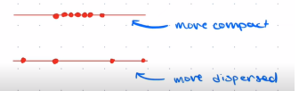
Measure of Dispersion
Kita ingin melihat seberapa rapat atau compact atau lenggang dari data kita.

Slide 25
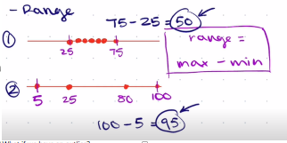
Dispersion: Range

Slide 26
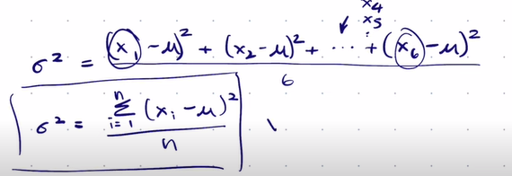
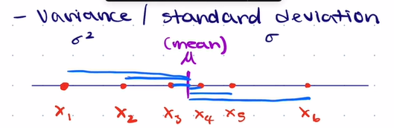
Dispersion: Variance and standard deviation

Slide 27
Mini Task-1
Deteksi Email Spam
Diberikan Data:
Kata “gratis” muncul di 80% email spam atau P(gratis |spam) = 0.8 dan 20% di email non spam
Kata “hadiah” muncul di 70% email spam dan 30% di email non-spam
Proporsi email spam adalah 60% sedangkan non-spam 40%
Hitung probabilitas email menjadi spam jika kata "gratis" dan "hadiah" muncul di dalamnya.
Clue: P(spam | gratis ∩ hadiah) = P(gratis ∩ hadiah | spam) * P(spam)/P(gratis ∩ Hadiah)
Silahkan diskusi di grup, challenge due:18 Desember

